Slide 1
Design & Implementation of embedded system for IMU-based jump event detection & Timing Analysis
Priyanka Moorthy

Slide 2
ABSTRACT
Athlete performance analysis plays a crucial role in modern sports training and injury prevention.
Jump performance, including take-off and landing timing, provides important insights into an athlete’s strength and coordination.
Traditional jump analysis systems often rely on high-speed cameras and expensive laboratory equipment.
An Inertial Measurement Unit (IMU) can measure motion using acceleration and angular velocity data.
This project focuses on designing an embedded system using IMU sensors and a microcontroller to detect jump events and analyze timing accurately.

Slide 3
Problem Statement :
Jump detection is commonly used in sports analysis fitness monitoring and rehabilitation system.
Existing method for accurate jump detection such as force plates and motion capture system provide high precision but have significant limitations:
They are expensive and not portable
Require control environments
Not suitable for everyday or wearable applications, therefore there is a need to develop a low cost portable and reliable jump detection system using embedded hardware and sensor

Slide 4
Objective
The main objective of this project is to design a reliable jump detection system using IMU sensor data.
The specific goals are:
To measure acceleration using MPU6500 sensor
To compute total acceleration magnitude from 3-axis data
To identify distinct phases of a jump (takeoff, flight, landing)
To reduce false positives caused by random motion
To implement an efficient algorithm on ESP32 suitable for real-time processing

Slide 5
Literature survey
Development and evaluation of an inertial measurement unit (IMU) system for jump detection and jump height estimation in beach volleyball
https://www.mdpi.com/1424-8220/24/24/7877
Vertical Jump Height Estimation Using Low-Sampling IMU in Countermovement Jumps: A Feasible Alternative to Motion Capture and Force Platforms
https://www.mdpi.com/1424-8220/24/24/7877

Slide 6
System overview
The system consists of an IMU sensor (MPU6500) interfaced with an ESP32 microcontroller using I2C communication.
The MPU6500 measures 3-axis acceleration data
ESP32 processes the sensor data in real time
A Finite State Machine (FSM) is used to analyze motion patterns
LED is used as an output indicator for jump detection
The system continuously monitors motion and detects a valid jump based on predefined conditions.

Slide 7
BLOCK DIAGRAM
MPU 6500 IMU
ESP32 used for real-time processing
MPU6500 interfaced using I2C protocol
Sampling rate ≈ 100 Hz
Acceleration converted to g-units for consistency
FSM implemented in embedded C
LED used as output indicator
The system operates continuously and processes data in real time.
ESP32 MICROCONTROLLER
JUMP DETECTION ALGORITHM
LED INDICATOR AND SERIAL MONITOR OUTPUT

Slide 8
Working principle
The system calculates the total acceleration using the formula:
A_total = √(Ax² + Ay² + Az²)
This converts 3-axis acceleration into a single scalar value.
Key observations:
At rest → acceleration ≈ 1g
During takeoff → acceleration increases (>1g)
During flight → acceleration decreases significantly (<1g, near 0g)
During landing → sudden spike (>2g)
This pattern is used to identify a jump event

Slide 9
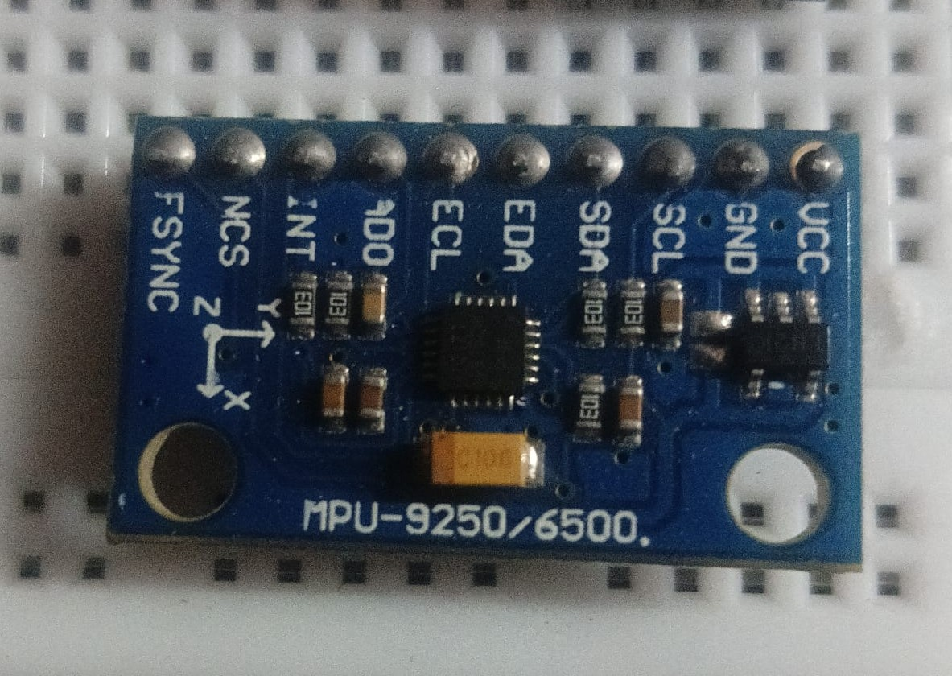
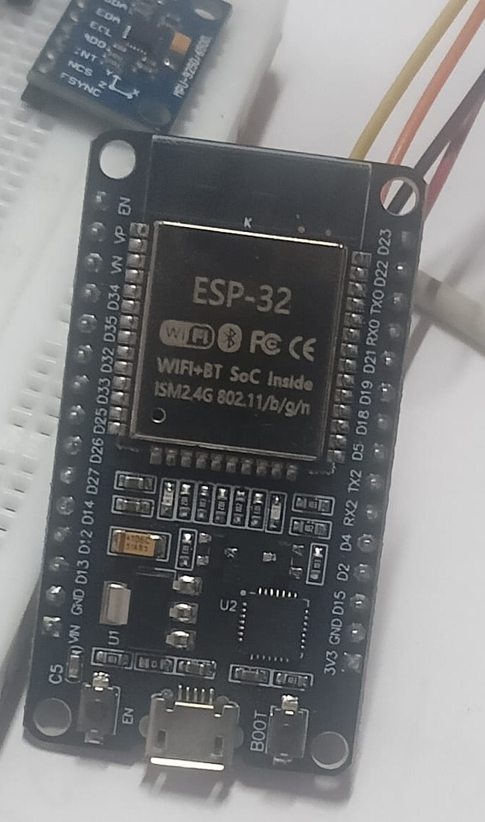
Requirements
HARDWARE REQUIREMENTS:
SOFTWARE REQUIREMENTS:
ARDUINO IDE
MPU6500 IMU Sensor
• 3-axis accelerometer
• 3-axis gyroscope
• Used to measure motion and orientation
ESP32 Development Board
• Main microcontroller used for
data processing and control
Other components
• Breadboard
• Jumper wires

Slide 10
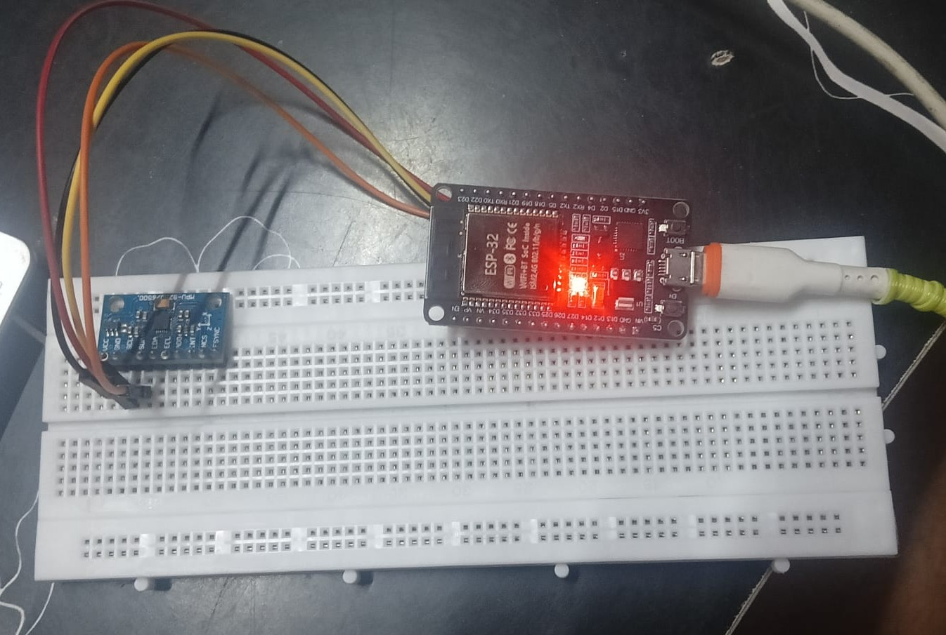
Hardware Implementation
ESP32 connected to MPU6500 sensor using I2C interface
Sensor powered using 3.3V supply from ESP32
LED connected as output indicator
System programmed using Arduino IDE

Slide 11
Key Insight
The most important characteristic of a jump is the flight phase.
During flight:
The body is in free fall
Acceleration approaches zero (0g)
This condition does not occur in normal hand movements
Hence, detecting the flight phase becomes the key criterion for distinguishing a real jump from noise or random motion.

Slide 12
Methodology
To improve detection accuracy, a Finite State Machine (FSM) is implemented.
States:IDLE→TAKEOFF→FLIGHT→LANDING→RECOVERY
Each state represents a phase of motion, and transitions occur based on acceleration conditions.
This ensures that only valid motion sequences are considered as a jump.
To avoid false detection, a duration-based condition is added:
Acceleration must remain below flight threshold for multiple consecutive samples
This ensures:
Short dips (noise/tap) are ignored
Only sustained low acceleration is considered
Thus, the system differentiates between real jumps and transient disturbances.

Slide 13
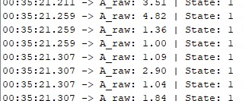
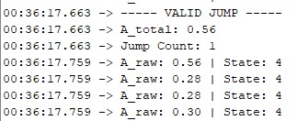

Experimental Results
No motion → No detection
Tap → No detection (false positives reduced)
Shake → Mostly ignored
Jump → Successfully detected
The FSM-based approach significantly improves reliability compared to threshold-only method.
OUTPUT
No motion detected
System at rest
System detected higher acceleration
due to random body movement but
flight phase not detected
No jump event detected
Jump sequence validated
Event detected.

Slide 14
Limitations
System may still respond to extreme irregular motions
No filtering applied to reduce noise
Gyroscope data is not yet utilized
Performance depends on threshold tuning
Future Task
Integrate gyroscope data for better motion understanding
Apply filtering techniques (low-pass filter)
Improve robustness using adaptive thresholds
Extend system for activity recognition

Slide 15
Conclusion
A jump detection system using IMU was successfully implemented using ESP32.
Key achievements:
Motion pattern-based detection using FSM
Identification of flight phase as key feature
Reduction in false positives
This approach provides a more reliable solution compared to traditional threshold-based methods

Slide 16
REFERENCE:
[1] D. S. Davis, D. A. Briscoe, C. T. Markowski, S. E. Saville, and C. J. Taylor, “Physical characteristics that predict vertical jump performance in recreational male athletes,” Phys. Therapy Sport,vol.4, no. 4, pp. 167–174, 2003.
[2] P. Klavora, “Vertical-jump tests: A critical review,” Strength Cond. J., vol. 22, no. 5, p. 70, 2000.
[3] J. Lin, J. Shen, J. Zhang, A. Zhou, and W. Guo, “Correlations between horizontal jump and sprint acceleration and maximal speed performance: A systematic review and meta-analysis,” PeerJ, vol. 11, Feb. 2023, Art. no. e14650.
[4] J. J. McMahon, J. P. Lake, C. Stratford, and P. Comfort, “A proposed method for evaluating drop jump performance with one force plat form,” Biomechanics, vol. 1, no. 2, pp. 178–189, 2021.
[5] K. Mackala, M. Fostiak, B. Schweyen, T. Osik, and M. Coch, “Acute effects of a speed training program on sprinting step kinematics and performance,” Int. J. Environ. Res. Public Health, vol. 16, no. 17, p. 3138, 2019.
[6] K. Kipp and H. Kim, “Relative contributions and capacities of lower extremity muscles to accelerate the body’s center of mass during countermovement jumps,” Comput. Methods Biomech. Biomed. Eng., vol. 23, no. 12, pp. 914–921, 2020.
[7] D. V. Cabarkapa, A. C. Fry, D. Cabarkapa, M. E. Parra, and M. J. Hermes, “Impact of accelerometer placement on assessment of vertical jump performance parameters,” J. Phys. Educ. Sport, vol. 22, no. 5, pp. 1340–1345, 2022.
[8] J. S. Arlotti et al., “Benefits of IMU-based wearables in sports medicine: Narrative review,” Int. J. Kinesiol. Sports Sci., vol. 10, no. 1, pp. 36–43, 2022.
[9] M. Straeten, P. Rajai, and M. J. Ahamed, “Method and implementation of micro inertial measurement unit (IMU) in sensing basketball dynam ics,” Sens. Actuat. A, Phys., vol. 293, pp. 7–13, Jul. 2019.
[10] T. Haynes, C. Bishop, M. Antrobus, and J. Brazier, “The validity and reliability of the My Jump 2 app for measuring the reactive strength index and drop jump performance,” J. Sports Med. Phys. Fitness, vol. 59, pp. 253–258, Feb. 2019.
[11] A. Vanezis and A. Lees, “A biomechanical analysis of good and poor performers of the vertical jump,” Ergonomics, vol. 48, nos. 11–14, pp. 1594–1603, 2005

Slide 17
THANK YOU

